Slide 1


Philip Kelso - CEO
Bounty Oil and Gas NL
Annual General Meeting
November 26, 2021
CEO Presentation
ASX Code: BUY
Offshore Carnarvon Basin

Slide 2
Disclaimer/Forward Looking Statements
This presentation contains forward looking statements that are subject to risk factors associated with the oil and gas industry. It is believed that the expectations reflected in these statements are reasonable but they may be affected by a range of variables which could cause actual results or trends to differ materially, including but not limited to: product price fluctuations, actual demand, currency fluctuations, geotechnical factors, drilling and production results, oil and gas commercialisation, development progress, operating results, engineering estimates, reserve estimates, loss of market, industry competition, environmental risks, physical risks, legislative, fiscal and regulatory developments, economic and financial markets conditions in various countries, approvals and cost estimates.
All references to dollars, cents or $ in this document are Australian currency, unless otherwise stated

Slide 3
2021 Highlights
Cerberus – Offshore Shallow Water Carnarvon Basin
Adjacent to Barrow Island
Targeting Prospective Resources of ~500 MMboip (recoverable 248MMbo)
Corporate
Petroleum Revenue $1.47 million (2020 2.91)
PEP 11 - A Gas Project
Preparations for Sea Blue 1 well targeting the large Gas and Carbon Capture and Storage Baleen Prospect considerably advanced by operator
Same plays as
Santos’ Dorado and Roc (>400 MMboe 2C) to the north, and
Stag and Wandoo Oilfields (>180 MMbo production) immediately adjacent
Bounty earning 25% by contributing $6 million to drilling 3 wells
Cash and current assets $ 4 million and no debt
$2.8 million new capital raised in 2021
Kane Marshall joins Bounty as COO.
Well and environmental management contracts let and letters of intent issued for well head and conductor equipment and calls to tender issued to several contractors with rigs in Australian waters

Slide 4

Corporate Snapshot
ASX Code | BUY
As at | 25 November 2021
Price Range YTD | $0.010 to $0.049
Shares Quoted | 1.37 billion
Options | Nil
ASX Closing Price | $0.010
Market Capitalisation | $13.7 million
Net Assets | $8.45million

Slide 5
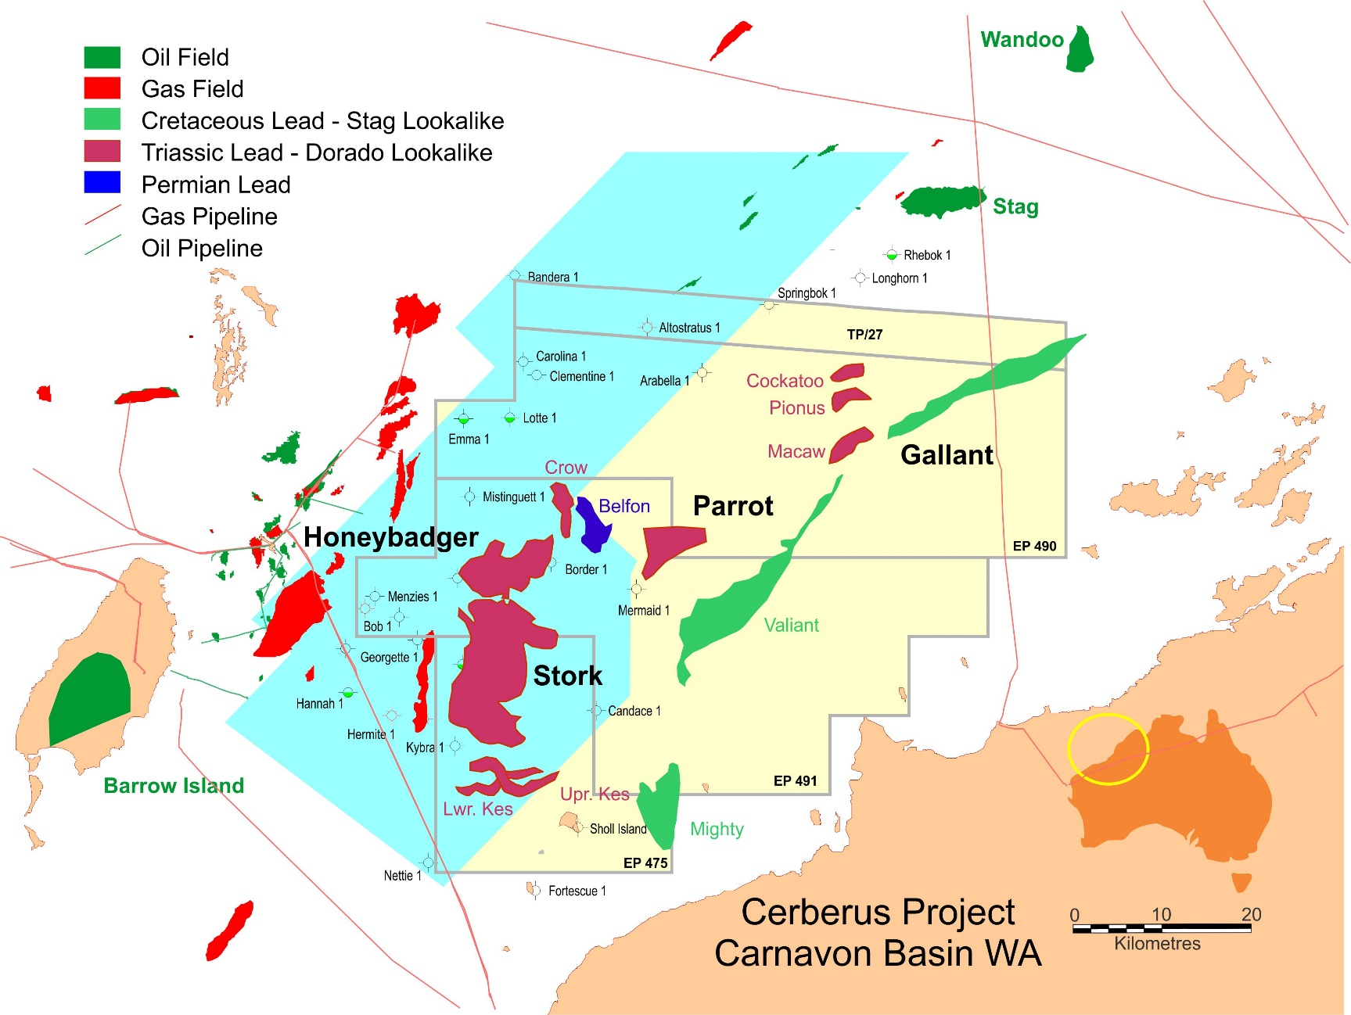
Cerberus – Carnarvon Basin WA.
Bounty initially targeting ~283 MMboip (141 recoverable) in Stork, Honeybadger and Gallant prospects, immediately up dip from proven oil fields

Slide 6
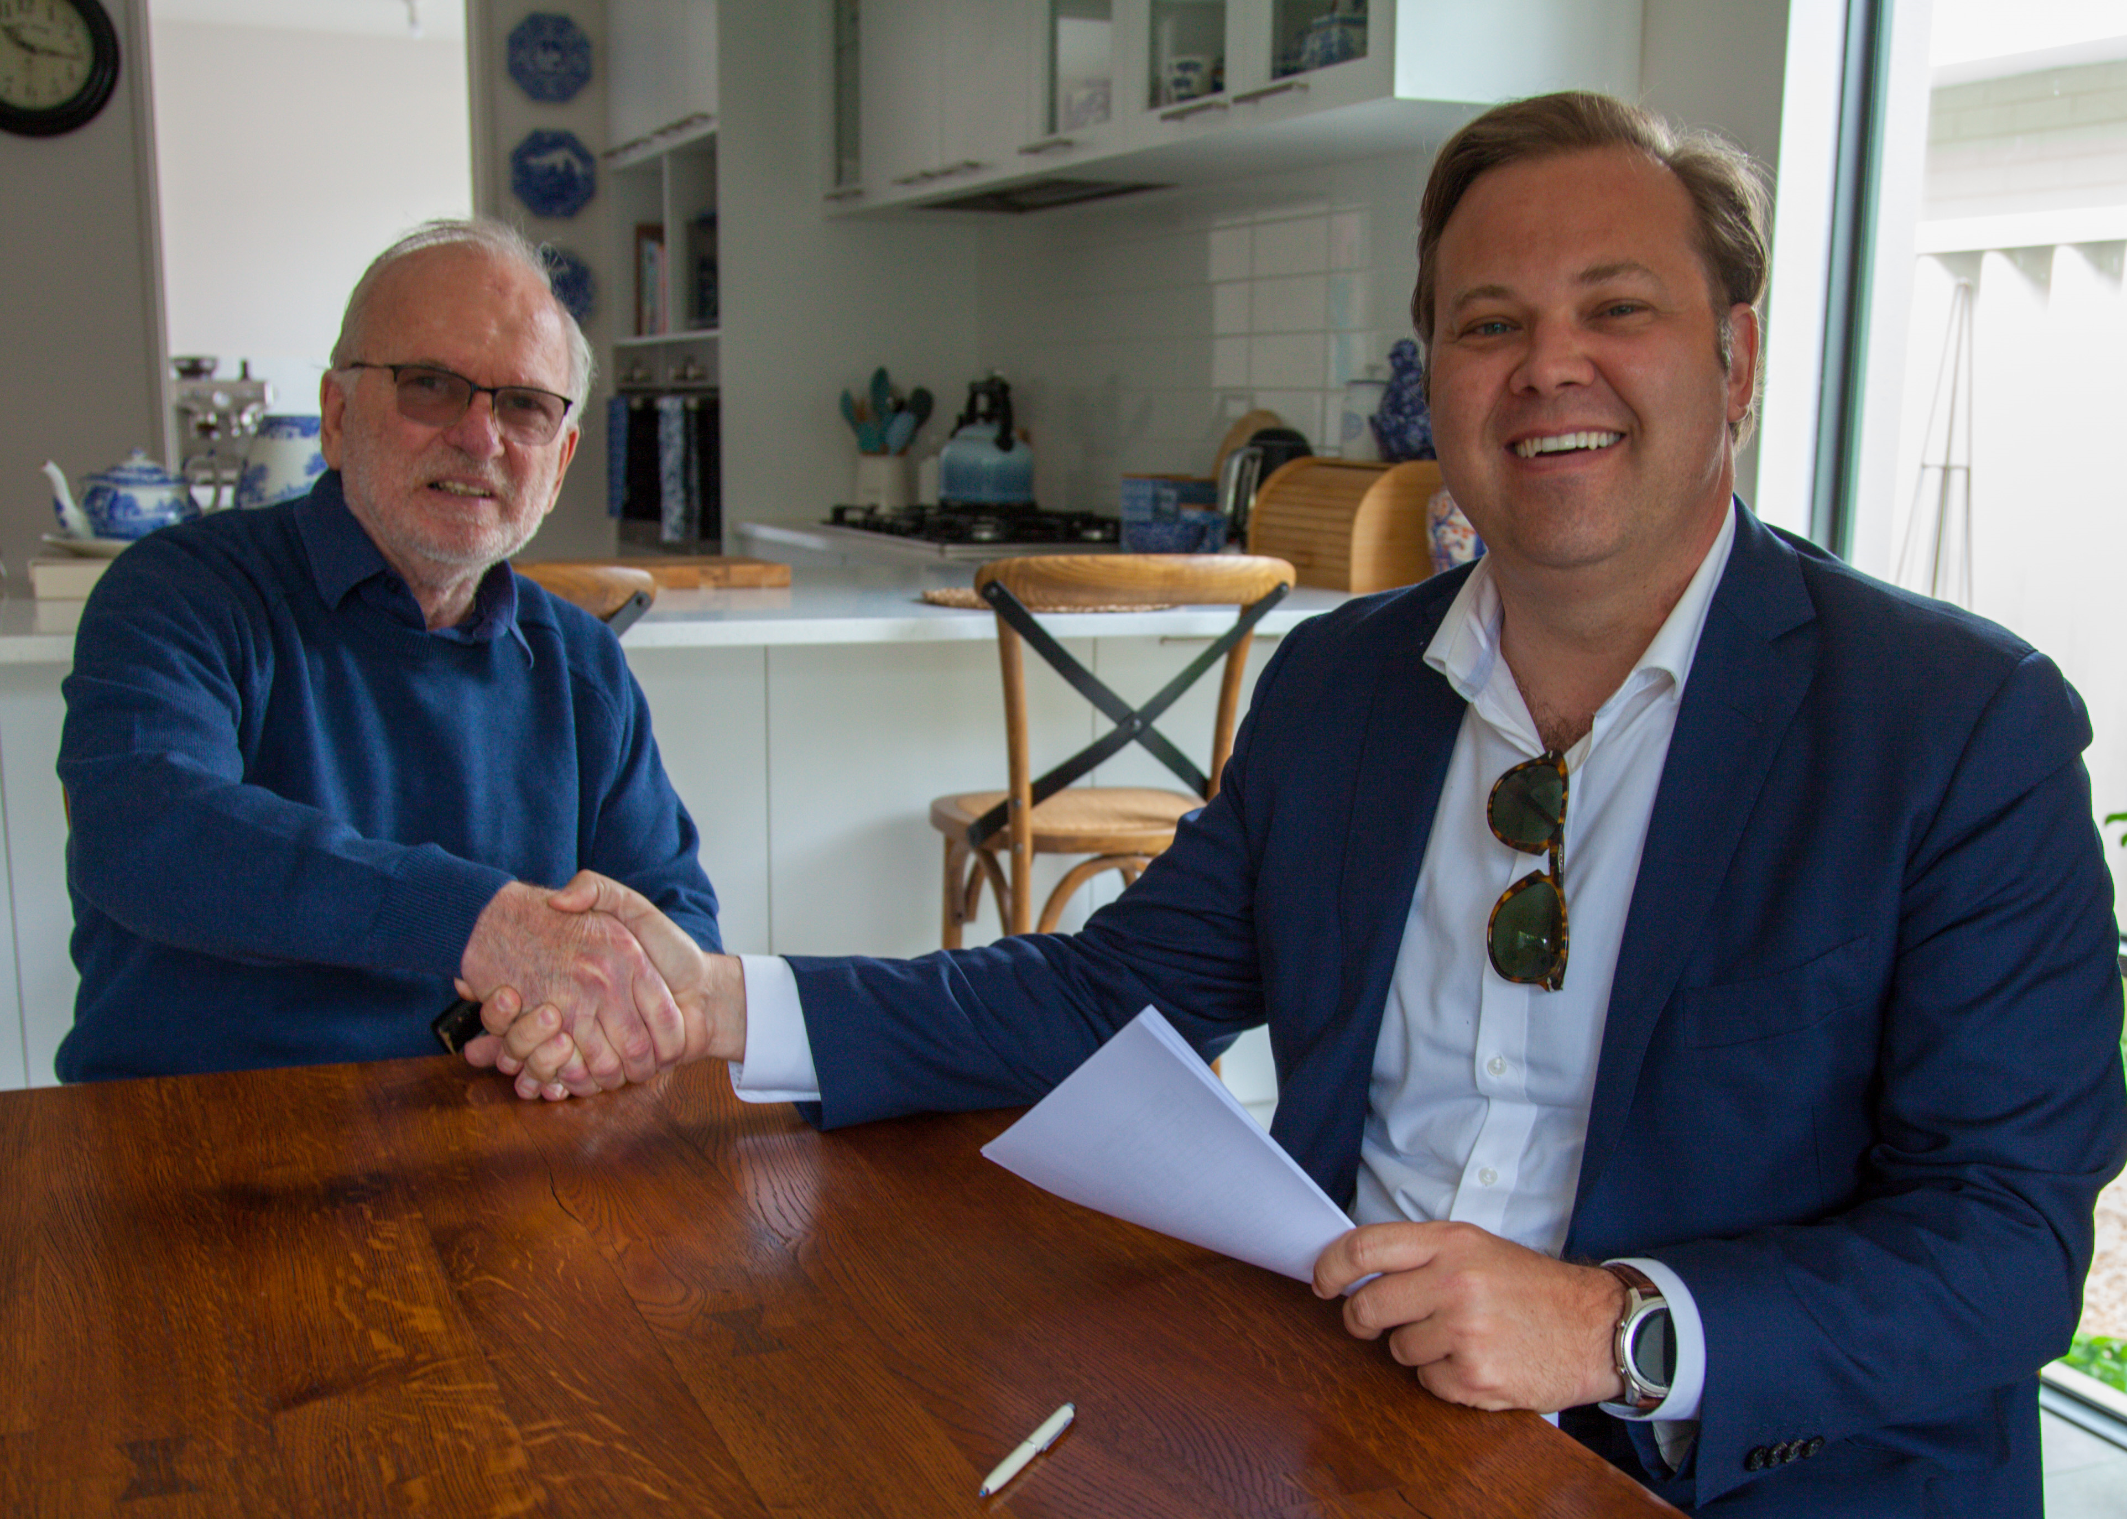
Cerberus – New team new prospects
Ted Jacobson
Kane Marshall
3,750 km² titles, close to infrastructure, 500 MMbo (248 recoverable) of prospective targets.
Bounty earning 25% by contributing $6 million towards 3 wells
Coastal Energy and Bounty will jointly operate the drilling programme
Prime Location, our partners have a proven record in oil finding in the Carnarvon Basin

Slide 7
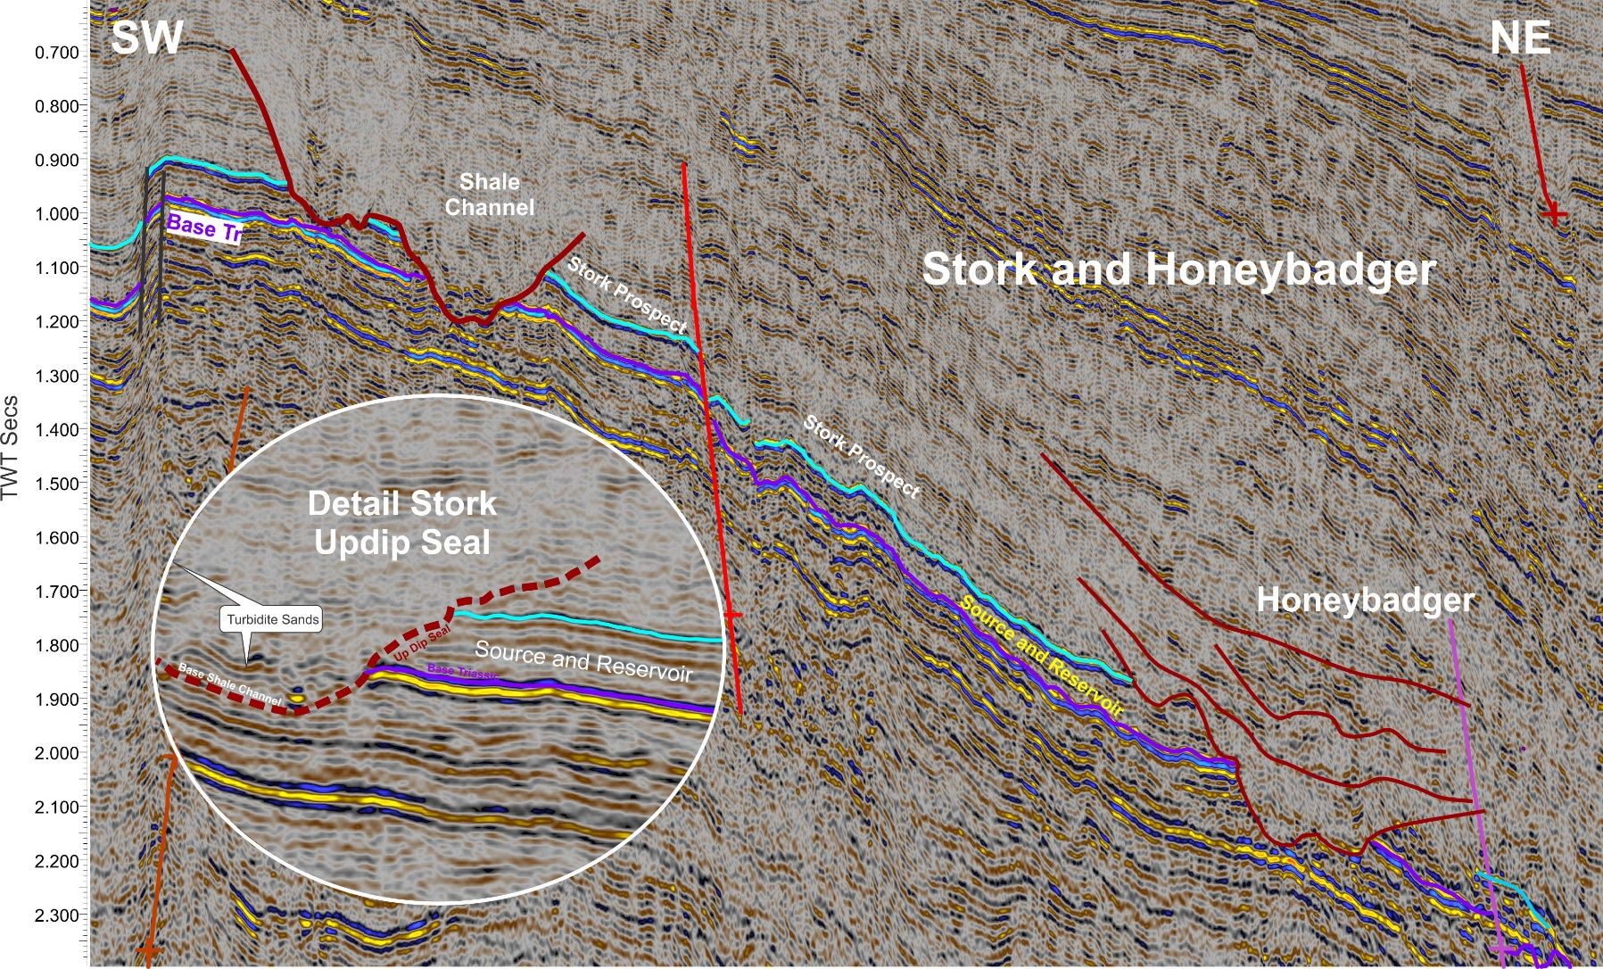
Stork Prospect targeting 94 MMbo in place
Stork prospect is sealed by shales in downcutting canyons and lies immediately up dip from mature source rocks and rimmed by gas chimneys.
Parrot 61 MMbo (recoverable 27 MMbo) in place targets the same sequence in a fault bound structural trap

Slide 8
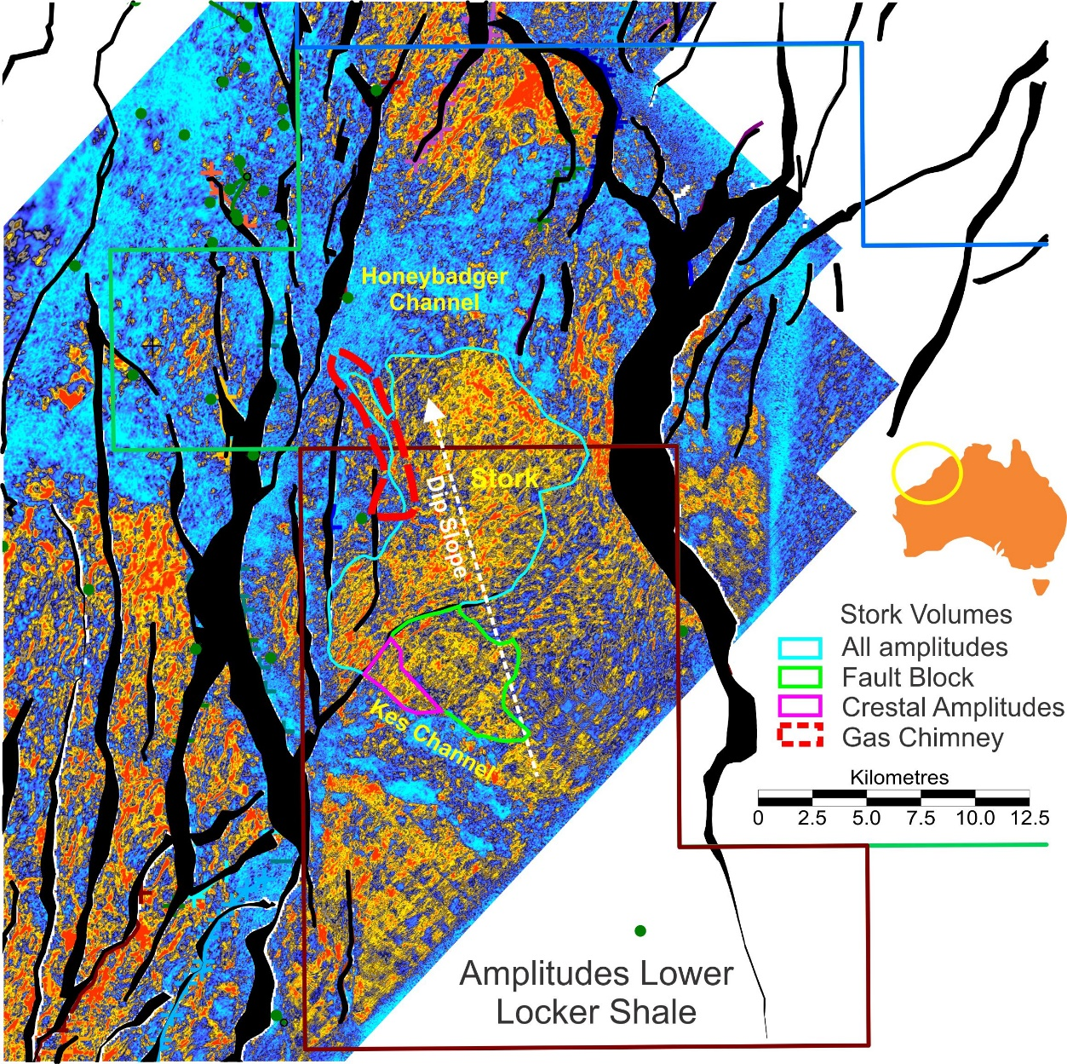
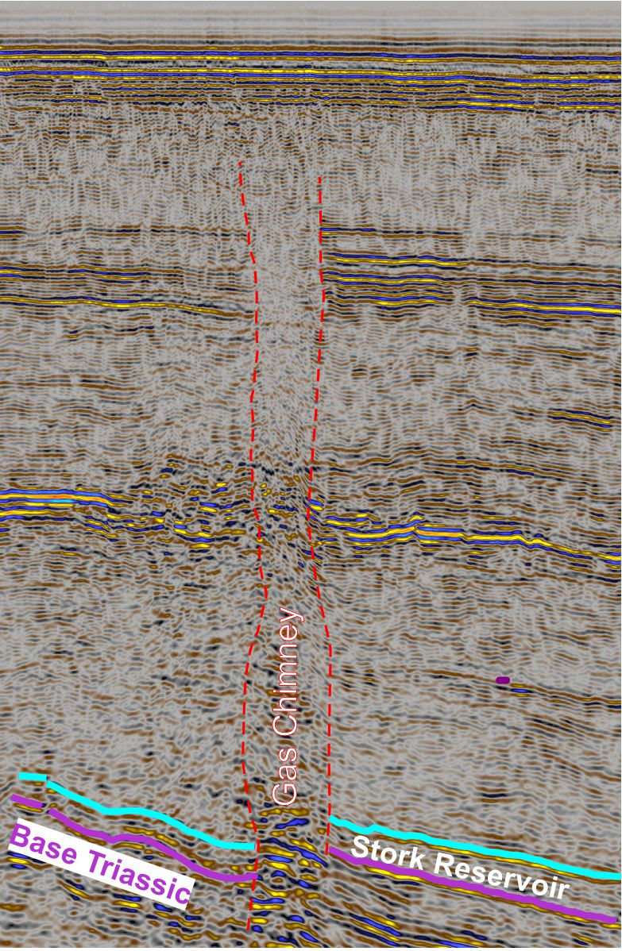
Stork
Deltaic sands in lower Triassic highlighted by amplitude extraction (warm colours), sealed down dip and up dip by cross-cutting shale channels (cold colours)
Three volumes identified:
  Crestal 3.5 km² low risk fault closure top seal by clay channel
  Fault Block 21 km² higher risk fault dependent closure
  Full sand package 122 km²
Gas Chimney over 10 km long showing migration up fault charging reservoir.
Positive evidence of charge in full sand package up dip

Slide 9
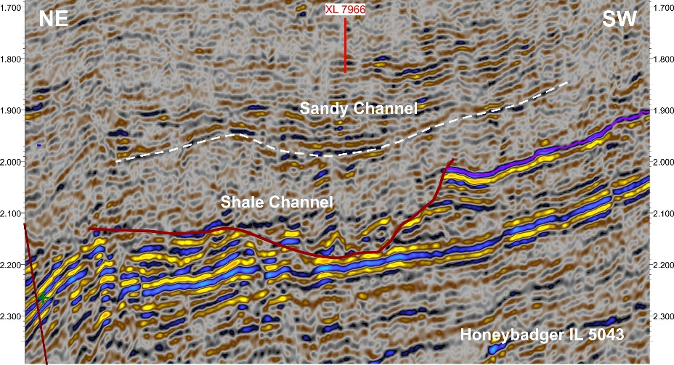
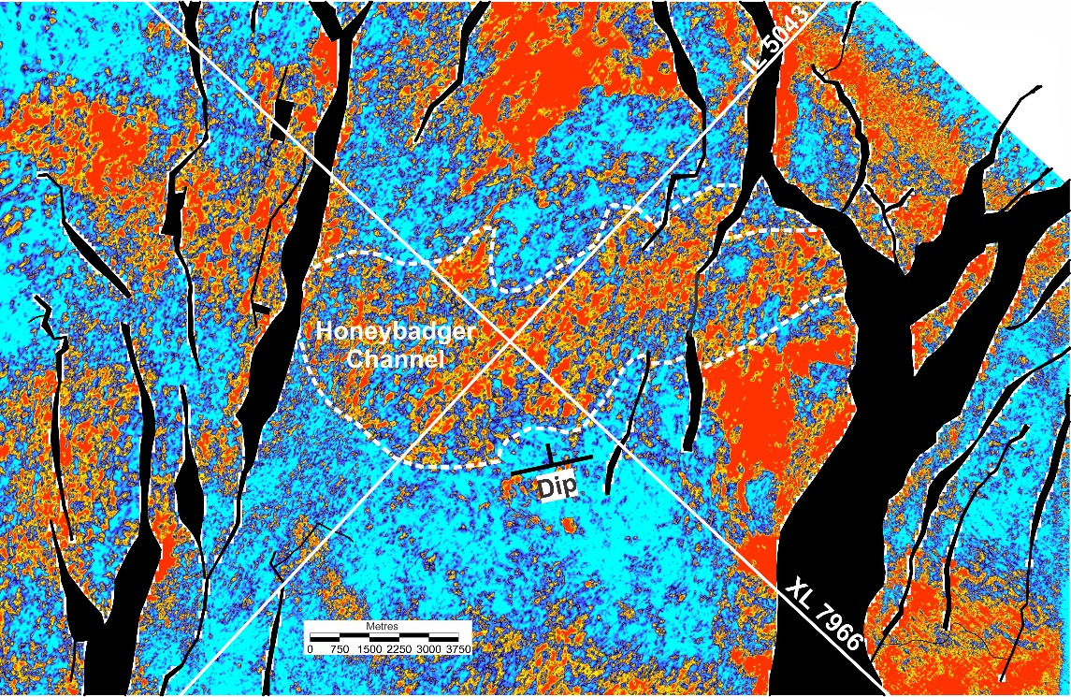
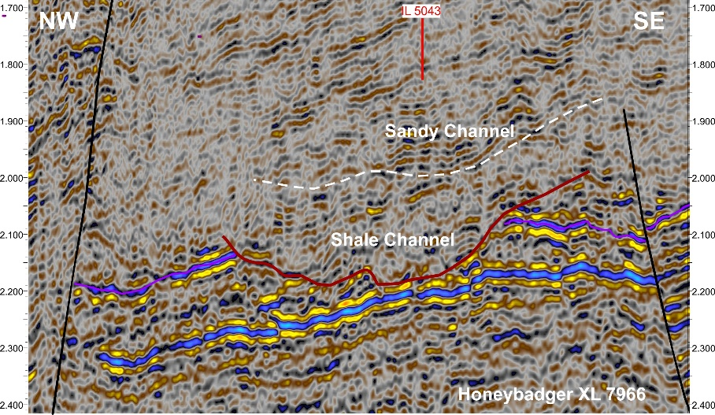
Honey Badger – Triassic Locker Shale
Honeybadger Sandy Channel 43 km²
Well sealed on all sides by clay canyon fill
Direct migration pathway from mature source rock in west up fault to fill entire volume
Honeybadger shale channel cuts basal Triassic (purple), stacked sandy channels (high amplitudes) embedded in shale (seismically quiet zones). Offers multiple stacked reservoirs
High amplitudes (warm colours) mark possible sand fill, cold colours mark low amplitude shale, completely sealing the prospect up dip

Slide 10
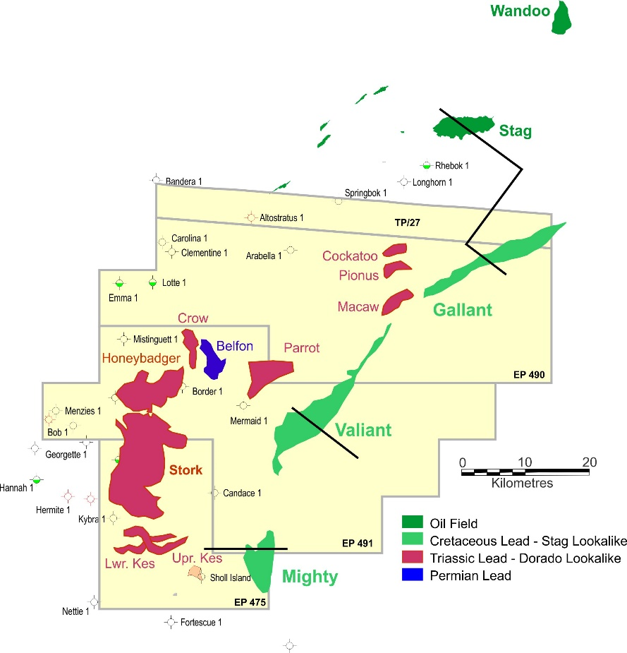
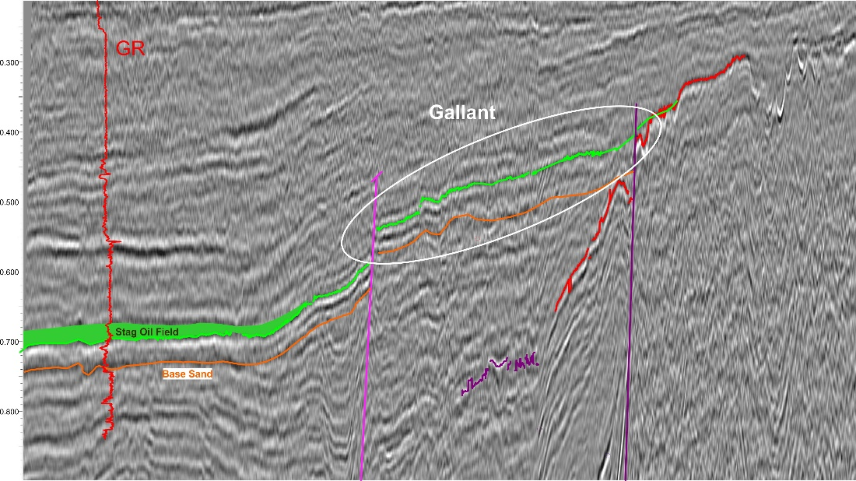
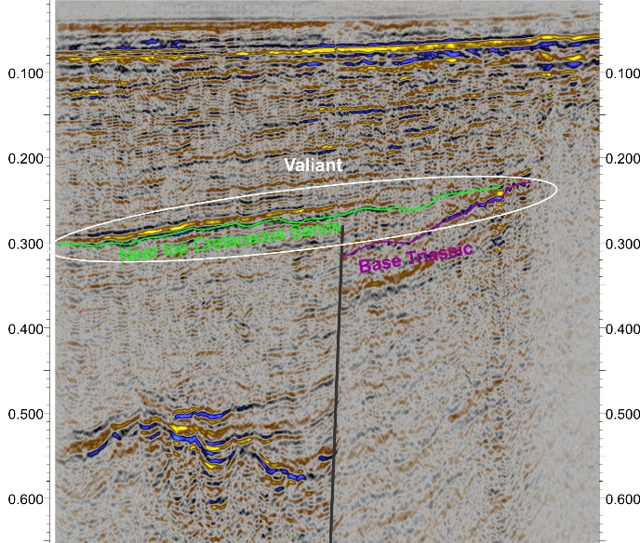
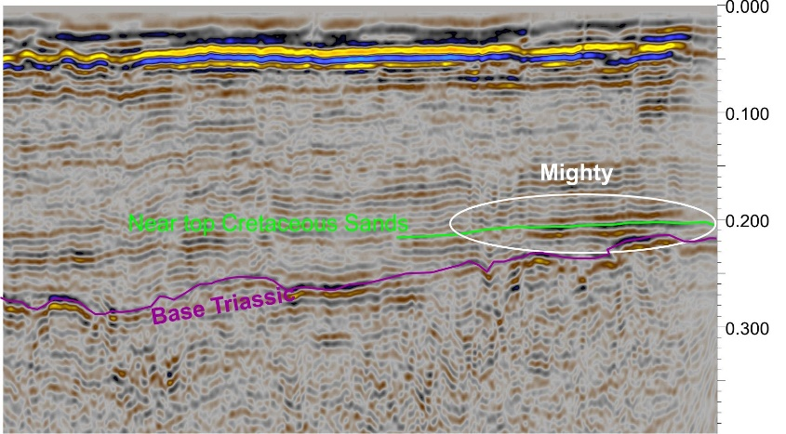
Gallant, Valiant, Mighty – Stag Lookalikes
 | Area
Gallant | 41 km²
Valiant | 61 km²
Mighty | 25 km²
Stag and Wandoo both occur in stratigraphic traps at pinch outs in lower Cretaceous sands and have produced 180 MMbo.
The same sequence pinches out against the Palaeozoic Basement along the eastern margin of the Cerberus lands
Shallow water and relatively shallow targets are attractive factors
Amplitude anomalies at pinchout and phase change along strike are positive indicators of potential hydrocarbons

Slide 11
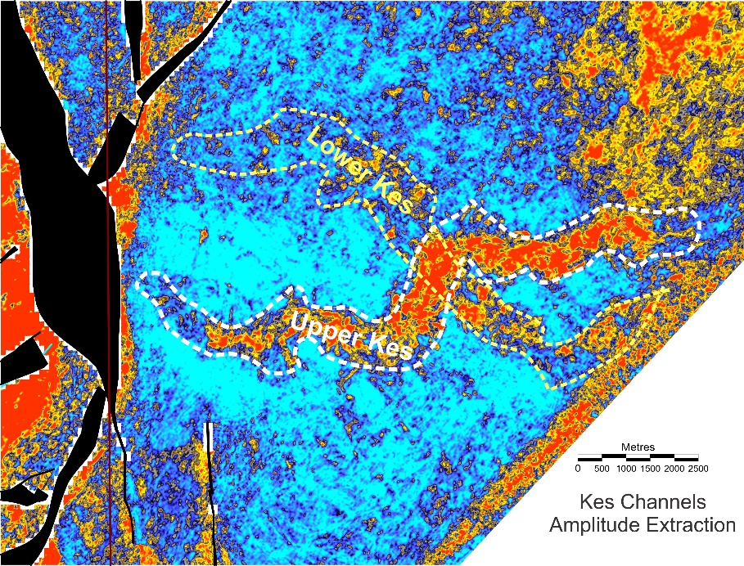
Cerberus Upside
11 other leads identified in similar settings add considerable upside
Shallow water and shallow targets combines to relatively inexpensive drilling using jack up rigs. Costs two to three times onshore Cooper Basin with targets 10 to 100 times larger
Immediately up dip from proven oil and gas fields and direct link to mature source rocks with short migration pathways
Abundant gas chimneys, hydrocarbon related diagenetic zones and shallow gas accumulation directly imaged on seismic all point to low risk of charge
Targets direct duplicates of proven substantial hydrocarbon resources
Option to acquire up to two additional tranches of 25% at $3 million each
Substantial Lead Inventory
 | Prospective Recoverable STOOIP MMbo
Lead | Low MMbo | Best MMbo | High MMbo
Honeybadger | 5 | 56 | 644
Stork | 4 | 39 | 398
Parrot | 4 | 27 | 205
Gallant | 2 | 18 | 149
Valliant | 3 | 27 | 220
Cockatoo | 0 | 5 | 60
Crow | 5 | 25 | 49
Upper Kes | 1 | 16 | 179
Macaw | 1 | 10 | 107
Mighty | 2 | 12 | 101
Pionus | 1 | 6 | 50
Belfon | 1 | 7 | 59
Total | 28 | 248 | 2222
Upper Kes (11 km²) and Lower Kes (11.5 km²) low stand channels completely sealed within clay canyon fill, upside to success at Honeybadger

Slide 12
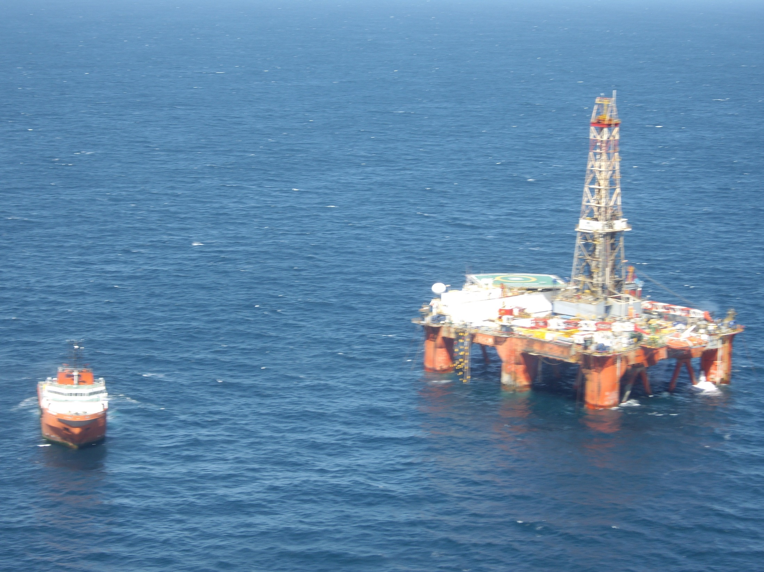
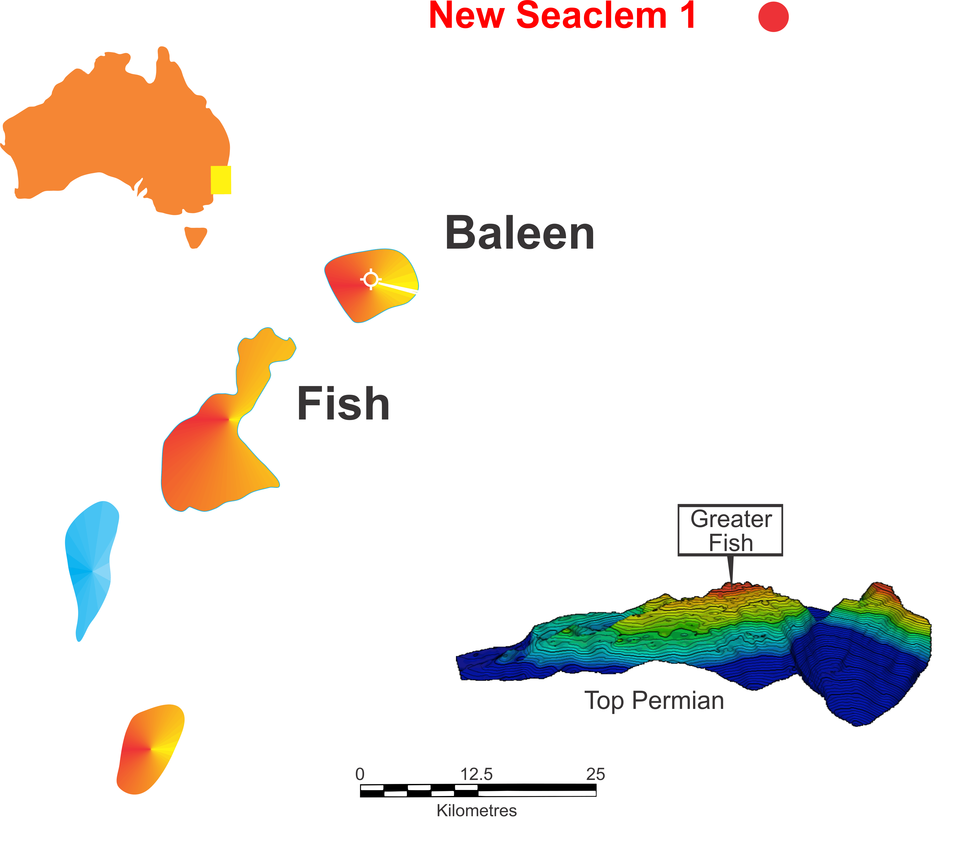
PEP 11 – Sea Blue 1 well – supplying a gas-starved market
Advent Energy well advanced on planning and contracting for Sea Blue 1 testing Baleen Prospect – Large gas prospect and Carbon Capture and Storage potential
NSW gas shortages becoming critical as vital plants close due to lack of gas
Bounty 15%

Slide 13
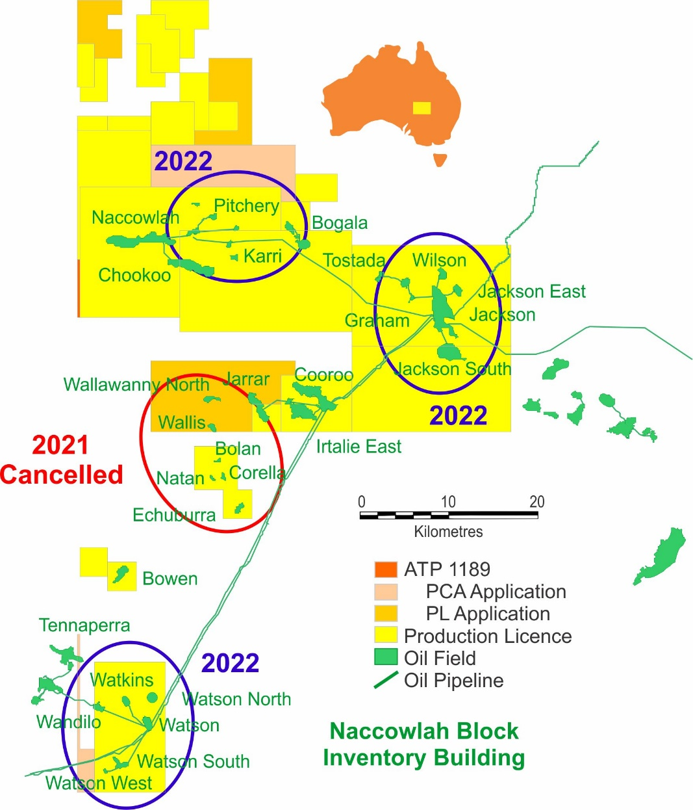
Naccowlah Block 2021-22 Drilling – Bounty’s Core Production
2021 Proposed Programme was deferred due to Covid 19 and Oil price drop
In previous years new drill helped to offset natural field decline.
2022 Programme under development in Watson, Jackson and Pitchery areas which, subject to oil prices, should lead to resumption of drilling in 2022/23

Slide 14
Surat Basin – Queensland Project Seriatim
Alton Field – Development (BUY 100%)
Recover ~48,000 bbl from existing wells. Qi = ~10-20 bopd
Develop ~168,000 bbls from attic and unswept oil. Qi = ~100 bopd
Eluanbrook – Updip Appraisal (BUY 81.75%)
Eluanbrook 1 produced oil and gas to surface, perforated in poor reservoir only, sucked in water from below OWC
Drill Eluanbrook 2 appraising ~200,000 bbls in up dip location in better reservoir. Qi = ~100-200 bopd
Downlands (BUY 100%)
Targeting 20 Kbo (low) to 0.7 MMbo (high) in Tinowan Sandstone member
Restarting gas flow ~ 2 million cfg/mth and 15 bbls liquids

Slide 15
The Plan 2021-22
Upside
Coming year will focus on Cerberus, de-risking prospects as much as possible to select three to drill
PEP 11, barring no further obstacles, drilling should advance in the year
Continue to evaluate significant growth opportunities as major companies move away from oil and gas allowing entry for Bounty.
Production
Bounty to focus on controlled lands
Excellent array of relatively low risk targets

Slide 16
ASX Listing Rules – Chapter 5 Reserves and Resources
ASX LISTING RULES 5.25 – 5.45
All Bounty Oil & Gas NL (Bounty) petroleum Reserves and Resources assessments follow guidelines set forth by the Society of Petroleum Engineers – Petroleum Resource Management System (SPE-PRMS). Bounty is compliant with recent listing rule changes for reporting of estimates as defined in Chapter 5 of the ASX Listing Rules.
INFORMATION REQUIRED UNDER CHAPTER 5 OF ASX LISTING RULES - THIS ASX RELEASE
For the purposes of Chapter 5 estimates of petroleum oil volumes presented in this release are:
Reported at the date of this release
Determined as an estimate of recoverable resources in place unadjusted for risk
Best Estimate Prospective Resources
Unless otherwise stated estimated using probabilistic methods
Reported as 100% net to Bounty unless expressed as targets
If specified as" boe" then they are converted from gas to oil equivalent at the rate of 182 bbls ≡ 1 million standard cubic feet of gas
The estimated quantities of petroleum that may potentially be recovered by the application of a future development project relate to undiscovered accumulations. These estimates have both an associated risk of discovery and a risk of development. Further exploration, appraisal and evaluation is required to determine the existence of a significant quantity of potentially moveable hydrocarbons.
QUALIFIED PERSON’S STATEMENT
The petroleum Reserve and Resources estimates used in this report and ;the information in this report that relates to or refers to petroleum or hydrocarbon production, development and exploration; Is based on information and reports prepared by, reviewed and/or compiled by the CEO of Bounty, Mr Philip F Kelso. Mr Kelso is a Bachelor of Science (Geology) and has practised geology and petroleum geology for in excess of 25 years. He is a member of the Petroleum Exploration Society of Australia and a Member of the Australasian Institute of Mining and Metallurgy.
Mr Kelso is a qualified person as defined in the ASX Listing Rules: Chapter 19 and consents to the reporting of that information in the form and context in which it appears.

